Slide 1
Day Care Application
By: 19819 Sawant Vinayak Suresh
19820 Sayyed Mohd. Aazen Kalim Ali
19823 Shaikh Mohammed Hassaan Asadullah
19831 Syed Md Junaid Warsi
Subject: Capstone Project Execution (CPE)
Mentor Name: Ms. Sameera Khan Ma’am
Guided By: Ms. Noorusabah Ma’am
Academic Year: 2021-2022

Slide 2
Contents
Overview of Project
Problem Statement
Solutions
Existing System
Objectives
Advantages
Proposed Methodology
Block diagram
Implementation tools
Screenshots
Conclusion

Slide 3
Overview of the Project…
We Have created Daycare App which will help parents to stay connected to their children.
Parents like having access to information about their child so having this app will give them peace of mind knowing that information is there whenever they need it.
By giving them away to pay you with just a few clicks on their device, it will reduce their hassle of managing paying child care fees.
In-Built tracking,(through video) will help parents will be able to know what are they doing? & we will provide the child’s daycare facilities.
Made with preschool kids and kindergarten teachers in mind, the app has support for powerful tools like monitoring, and academics.
In built Chat feature will help the owner and parents to stay in contact virtually.

Slide 4
Problem Statement
User Friendly:
Struggling to even use daycare software will just cause more frustration in the long run. Many existing software’s were buggy and have minimal features which were tiring to use.
Schedule and Data Keeping :
Existing software’s were unable to successfully manage the data which caused difficulty for daycare staff to manage data of multiple children.
Lesser Communication (Lil ones with their parents):
Existing software’s were unable to form a constant and good communication with parents which we tried to overcome in our app by providing real-time logger system.

Slide 5
Problem Statement (Contd. )
Payment Options:
Existing software’s were unable to provide electronic fund transfer facility which we provided in our software.
Flexibility:
Tools are provided to Admins with uploading Information & parent can and view the given information at any time or with no internet connection
Speed:
The User Interface (UI) is designed keeping in mind the guidelines and showing data according to the need of the user. It shows no ads or unnecessary information. The App also has a clean Interface & supported for older Android Versions

Slide 6
Solutions
Daycare App. offers an easy to use communication system is one of the top priorities you should look for when choosing a daycare software.
It creates a safer environment for kids eliminating various social problems.
Daycares probably have many children to look after each day so being able to input data quickly and easily is important. By using the app the staff can spend less time on “paper work” and more time looking after kids.
If you have an app that can help parents pay for daycare services and schedule payment reminders, it will make it easier for Daycare and the parents of the kids you look after.
This app provide many new features which will be user friendly and easy to use.
It enhances the chances of learning new abilities and skills in kids.
Daycare App.

Slide 7
Existing System
The particular features for circumstances that lack on similar existing apps are:-
User Friendly
Speed
Flexibility
Schedule and Data Keeping
Digital Payment Options
Lesser communication
To sum up everything that has been stated so far, Here comes our app which makes it unique.

Slide 8
Objectives
Child Care Business Management
Parent Engagement
Secure & Contactless
Tuition Collection and Payment
Staff Management
Track Attendance
Monitor & Report Staff-Child Ratios,
Drop off & Pick up
Online Registration
Early Childhood Learning

Slide 9
Objectives
Child Care Business Management – Our app gives you the power to manage every aspect of your daycare — regardless of the size and structure of your organization. From invoicing, billing, and payments to family and child data to staff and student-to-staff ratios, everything you need is in one place. Our daycare app provides comprehensive solutions that save you time and money by streamlining your administrative tasks so you can focus more on the growth and development of the children you serve.
Parent Engagement - When you are looking to build stronger connections with the families you serve, a parent engagement solution is the answer. With a fully integrated and complete parent engagement solution that also includes classroom management, you can immerse parents into their children’s day-to-day activities – from tracking developmental milestones to sharing photos and videos to enabling two-way communication.
Secure & Contactless - Safety has always been a top priority for daycare centers, but it has become even more important in today’s world. Eliminating unnecessary foot traffic is key in providing a safer environment. That’s why our app enables contactless check-in/out with the choice of QR codes. And, we also offer security hardware so you can ensure your center is truly secure.

Slide 10
Objectives (Contd. )
Tuition Collection and Payment – Our app take the hassle out of child care billing with all of the touchless payment options you need — electronic fund transfer (EFT), online or completely automated. Parents can also do an in-person point-of-sale transaction if needed. Tuition collection is a seamless experience for daycare providers.
Staff Management – Daycare’s staff is the hub of its successful daycare business. Monitoring and complying with staff-child ratios, allowing staff to clock-in/out and having staff records available readily is key to better managing your employees.
Track Attendance - Record and maintain up-to-the-minute information on the children in your care with attendance tracking.
Monitor & Report Staff-Child Ratios - Monitor and manage staff-child ratios for proper development and to meet state requirements.

Slide 11
Advantages
Staff Management
Online Registration
Track Attendance
Chatting Functionality
Monitor & Report Staff-Child Ratios
Secure & Contactless Payments
Tuition Collection and Payment
Early Childhood Learning
No Internet Connection(is required to save info.)

Slide 12
Proposed Methodology
As we Know, System Methodology refers to software development model that we select to develop the project. In our project, we have used Incremental Model of Software Development Life Cycle. Before planning, we have understand the old system thoroughly and determined how computers can best be used in order to operate efficiently.
The reason behind selecting this model is as follows:
Software development is easier
More Flexible
Easier To Test & Debug
Easier To Manage
More flexible
More cost effective

Slide 13
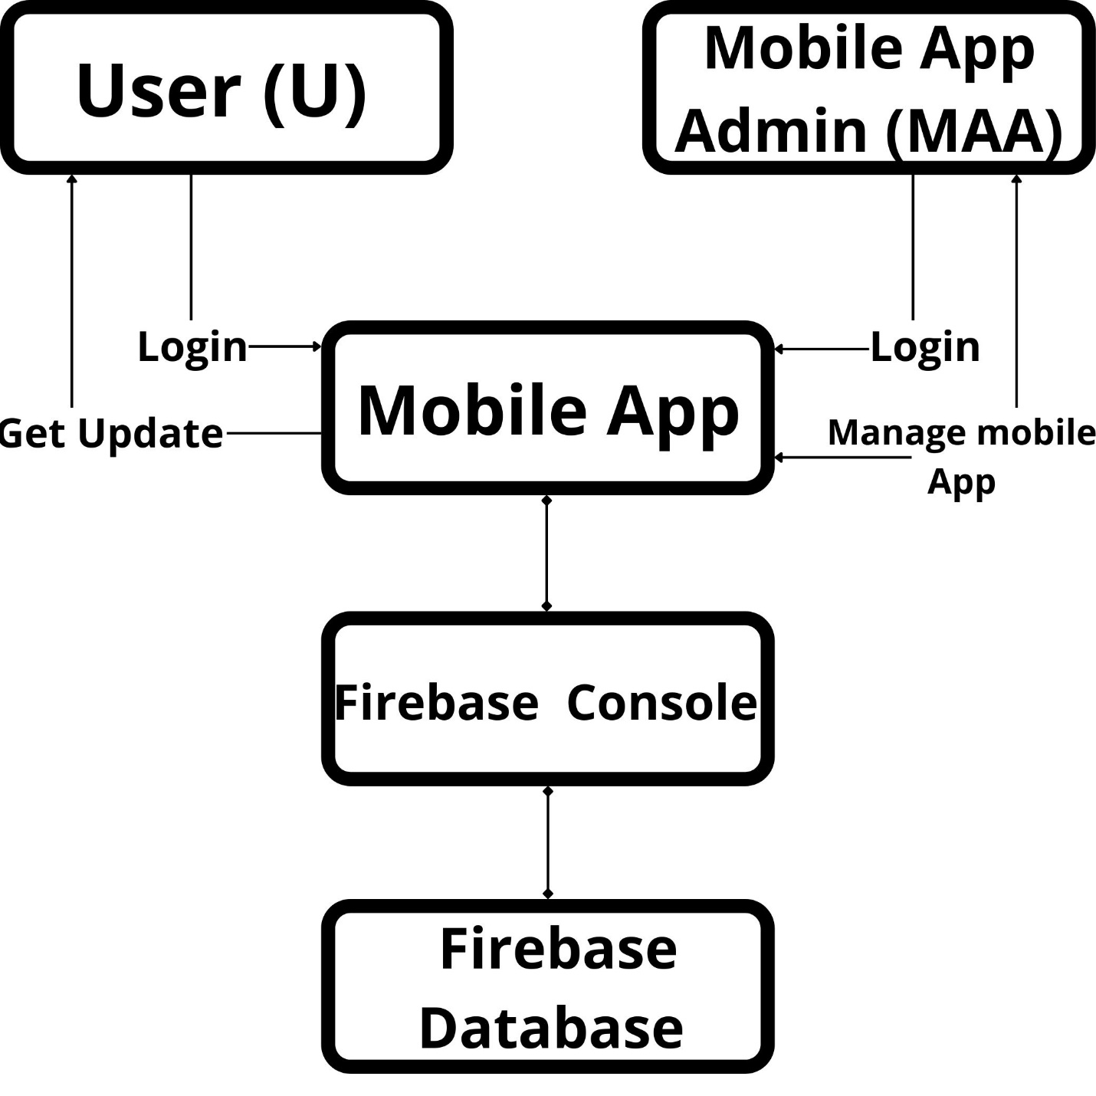
Block Diagram
Both the User’s will
Register > Login > Home page > Information will be displayed/can be updated

Slide 14
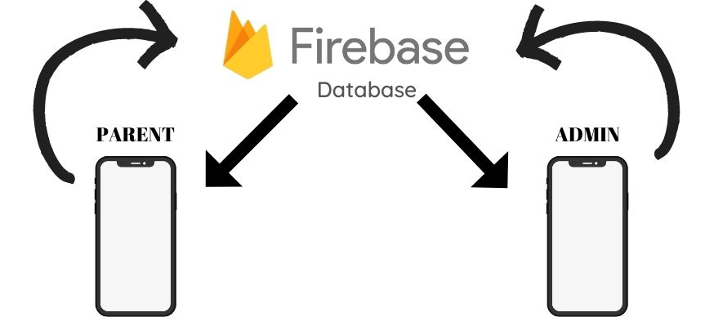
Block Diagram (Contd. )
There will be 2 sections here
Admin
Parent
Admin:
Has a permission to
Show what child is doing currently
Update attendance
Change child's report
Parent:
Has viewer’s permission to
See attendance
View info

Slide 15
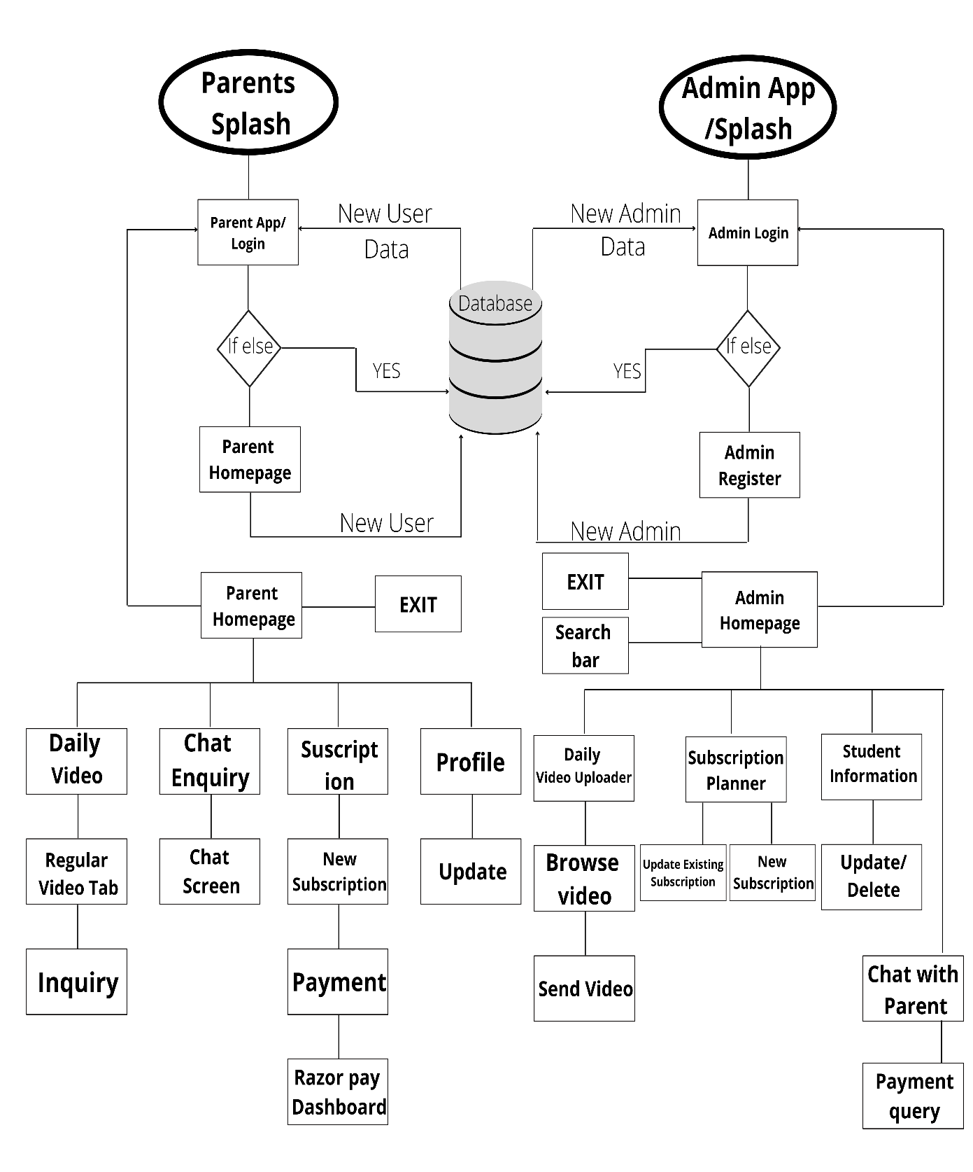

Slide 16
Implementation Tools
Software Requirement:
Android Studio
Android emulator
Firebase
Hardware Requirement
4GB RAM recommended.
500 MB disk space
1 GB for Android SDK.
Java Development Kit (JDK) 7 or above.
Microsoft Windows 8/8.1/10/11 (32 or 64 bit).
Mac OS X 10.8.5 or above.
Languages used
Java
Android Studio

Slide 17
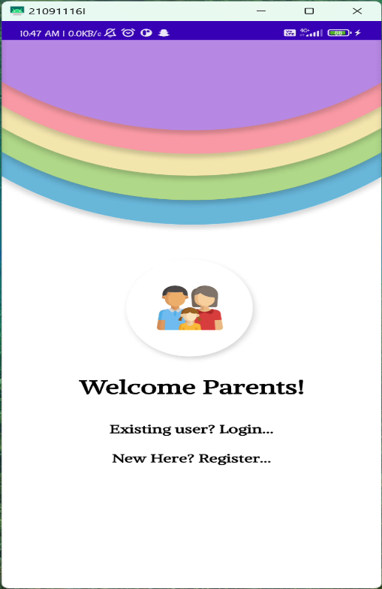
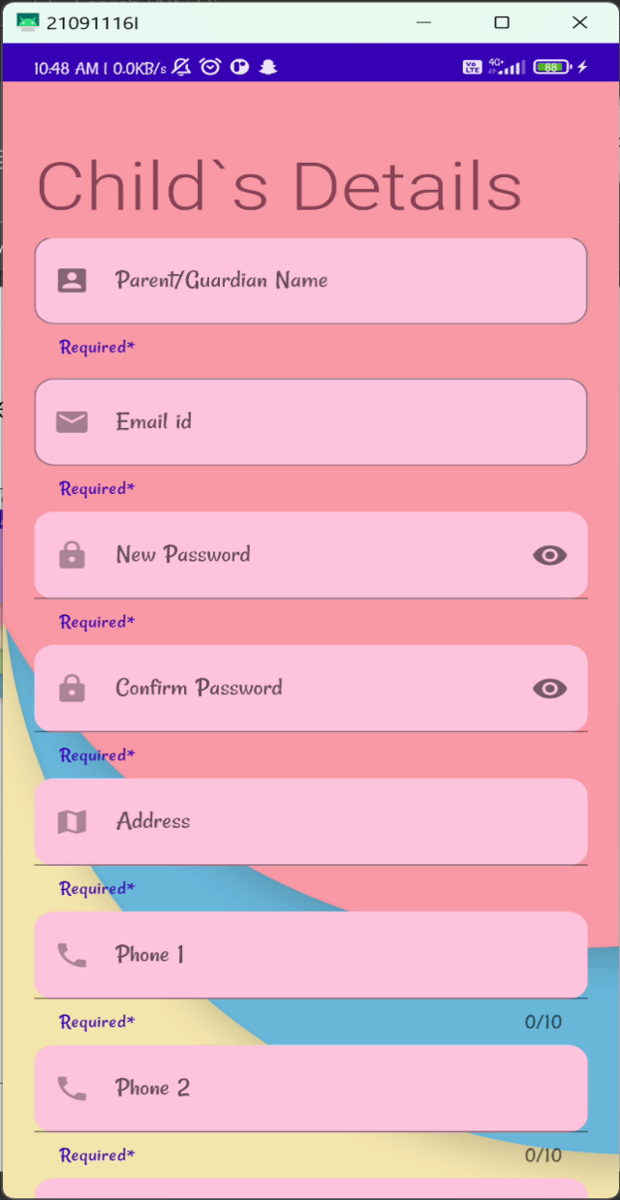
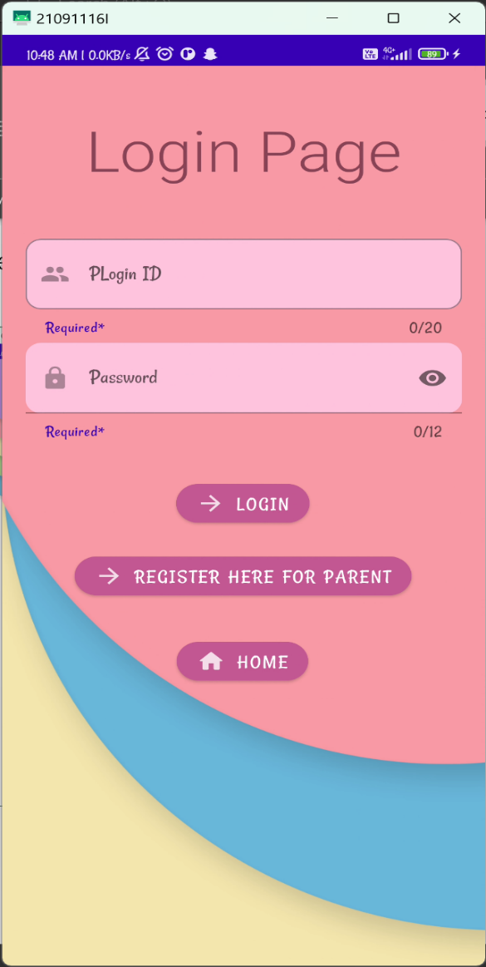
Screenshots
In app screenshots (Login)

Slide 18
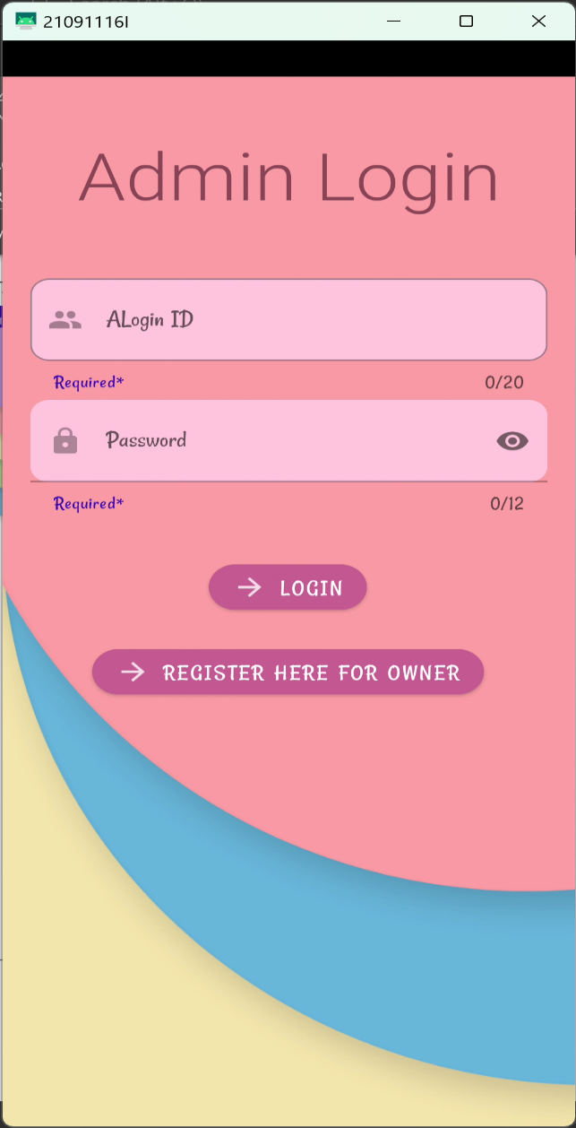
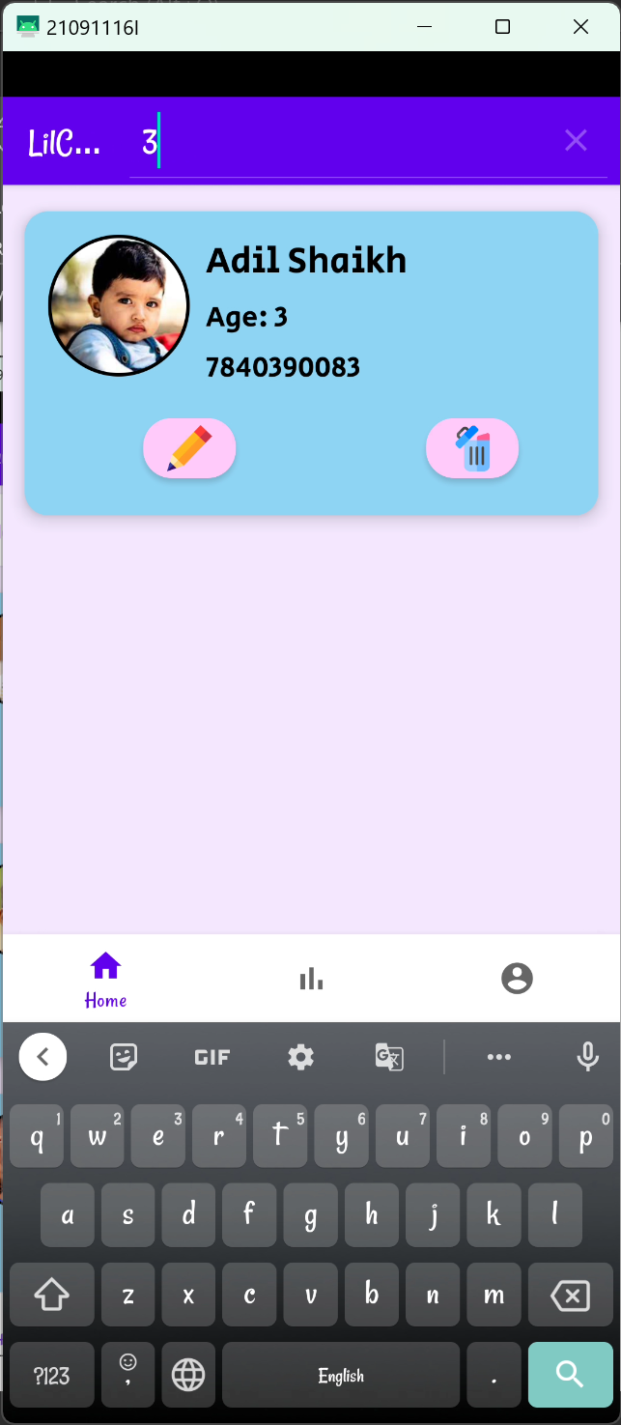
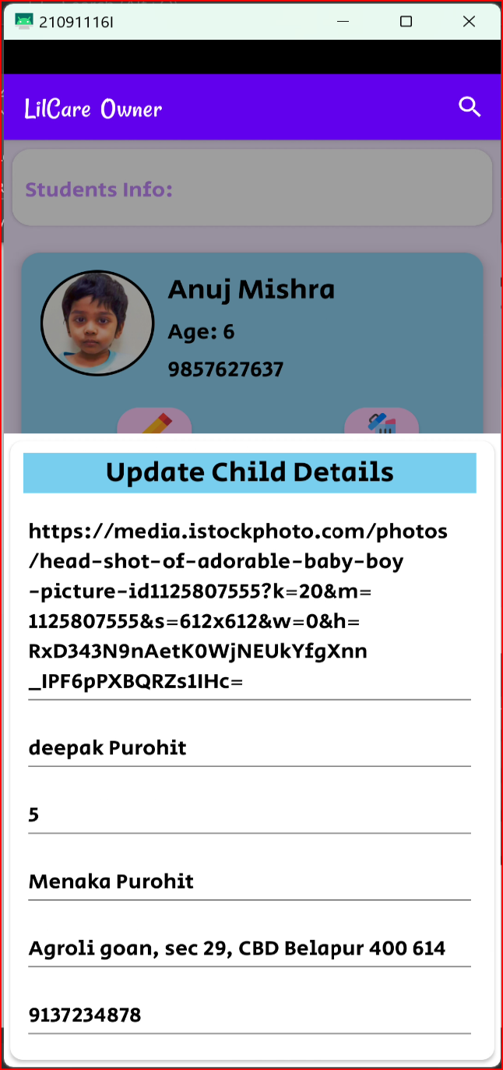
Screenshots (Contd. )
In app screenshots(Details page)

Slide 19
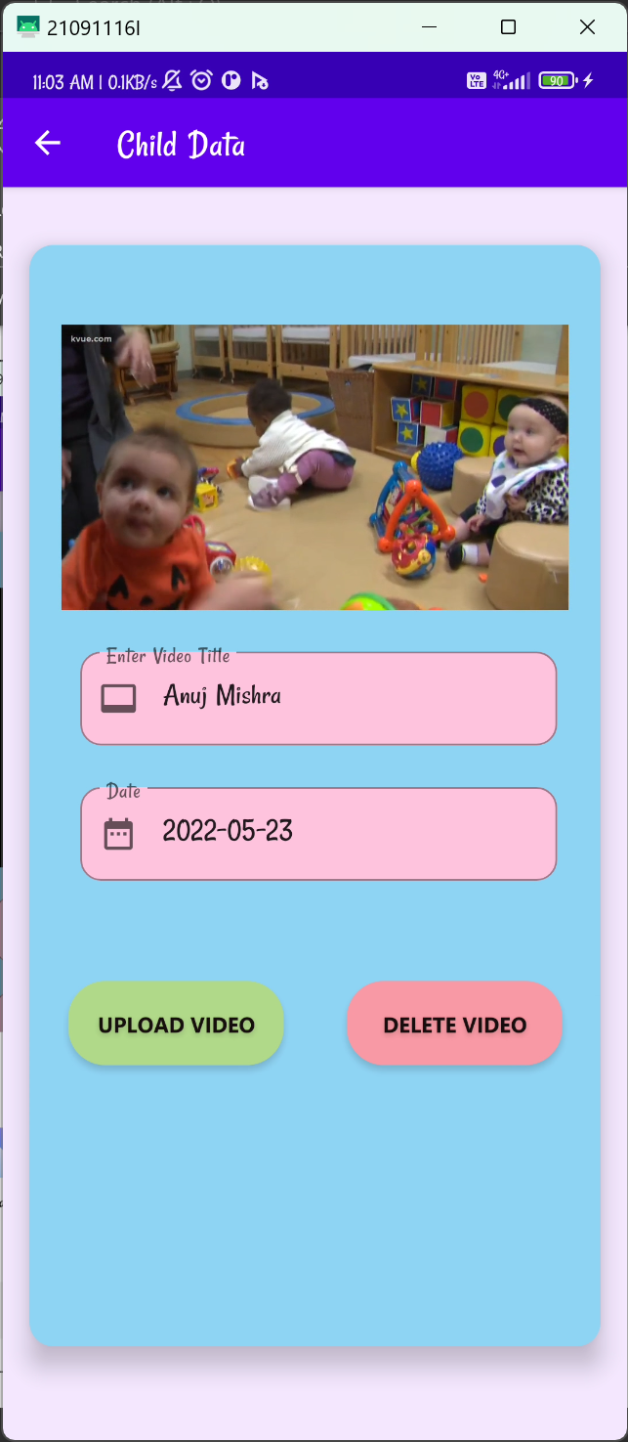
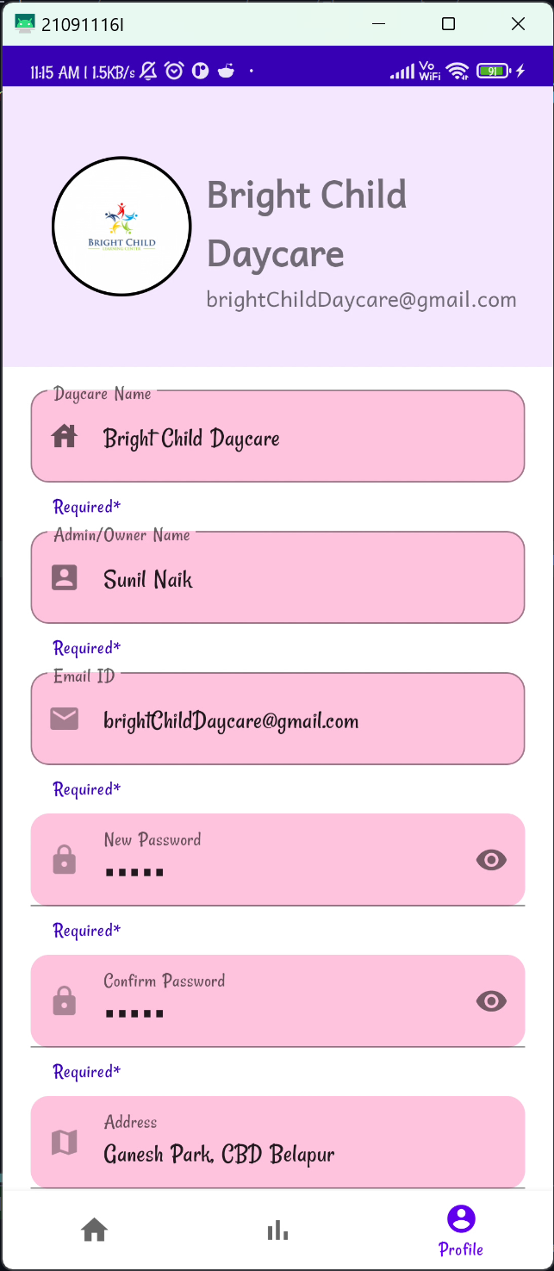
Screenshots (Contd. )
In app screenshots(Profile page)

Slide 20
Conclusion
If a child is starting school or daycare for the first time, the parents might be a bit apprehensive. After all, they have never been away from their children. Our App Provides feature of parents to child any time.
If you have an app that can help parents pay for daycare services and schedule payment reminders, it will make it easier for Daycare and the parents of the kids you look after.
This app provide many new features which will be user friendly, easy to use & provide hassle-free.

Slide 21
Thank You
Daycare App.

